Slide 1
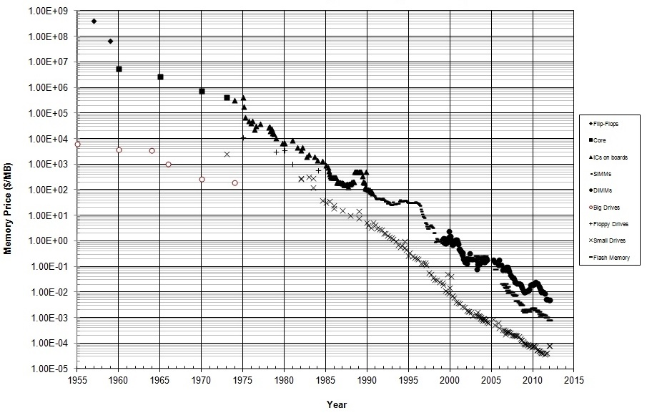
Historical Cost of Memory & Storage
Notes:
Notes:
This is a logarithmic scale.
Both memory and disk costs have been dropping exponentially.
In 2010, memory cost roughly 1 cent per megabyte of memory and 1 cent per 100 MB of storage.
Reference: http://datarep.tumblr.com/post/60074240896/historical-cost-of-computer-memory-and-storage

Slide 2
Computer vs. Data
Moore’s Law vs. Data Deluge
Moore’s Law states that computing power will double every 18 months
Data Deluge:
Data is now doubling every 12 months.
According to IBM, build out of IoT will double data every 12 hours
Notes:
Notes:
The prediction of Moore’s Law has been very accurate for the last few decades.
Until 1900s human knowledge doubled every century.
By end of WWII, human knowledge was doubling every 25 years.
Reference:
http://www.industrytap.com/knowledge-doubling-every-12-months-soon-to-be-every-12-hours/3950

Slide 3
Evolution of Data Science
Data
What should I do?
Decisions
Actions
What will happen?
Why did it happen?
What happened?
Manual process
Notes:
Notes:
Data science is evolving from simply trying to figure out what happened in the past to
Going deeper and discovering why it happened to
Predicting the future and figuring out what will happen
The final goal it to not only figure out what will happen but to make decisions preemptively and take actions automatically
References:
Microsoft: DATA203x Data Science and Machine Learning Essentials, edx.org

Slide 4
Who Performs Data Analytics?
Domain Expertise
Data science is a multi-disciplinary activity
Data
Science
Code/Computing Expertise
Math/Statistics
Notes:
Notes:
Rarely would one person have all of this expertise.
Data science requires collaboration between experts in each discipline.
Reference:
BerkeleyX: CS100.1x Introduction to Big Data with Apache Spark, edx.org

Slide 5
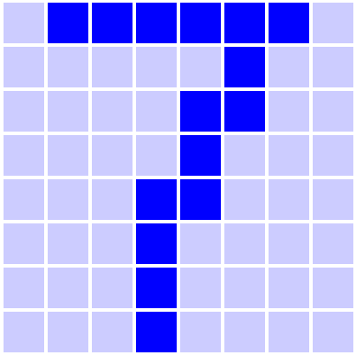
Azure Machine Learning Studio
手写数字识别
7
8×8个不同的特征值
动手实验内容
使用 AML Studio 创建、训练分类模型以及评估预测模型
将创建好的模型发布成Web Service

Slide 6

Azure HDInsight
工具
Microsoft Azure Storage Explorer
Jupyter Notebook
动手实验内容
部署一个Apache Spark集群
利用Microsoft Azure Storage Explorer来管理集群数据
使用Jupyter工具对数据集进行操作
使用Jupyter工具创建一个机器学习模型
Name Node
1
Master Node
Contains Blocks
B1, B2, B4
2
Data Node A
Contains Blocks
B1, B3, B2
Data Node B
3
Data Node C
…
Data Node D
Slave Node
B - Block
Client
Cluster

Slide 7
动手实验
https://aka.ms/thu-workshop

